Slide 1

Loan Approval
Prediction

Slide 2

Content:
Objective
Steps for Developing the Model
Tableau Dashboard
Key Insights
Web App
Conclusion
Project Git/Drive Link

Slide 3

Objective:
This project aims to develop a machine-learning model to predict the approval status of loan applications. The model aims to assist financial institutions in making informed decisions by evaluating various factors influencing loan approval. By analyzing historical data, the model will identify key attributes and patterns that correlate with approving or rejecting loan applications.

Slide 4
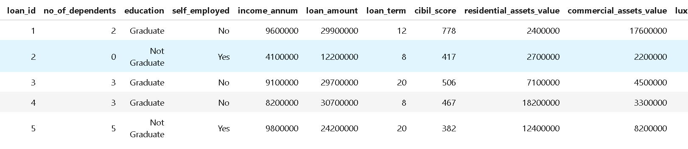
Steps for Developing the Model:
1. Data Collection
Objective: Gather relevant data on loan applications, including applicant details, financial attributes, and loan status.
Actions: Obtain historical loan application data from financial institutions or public datasets.

Slide 5

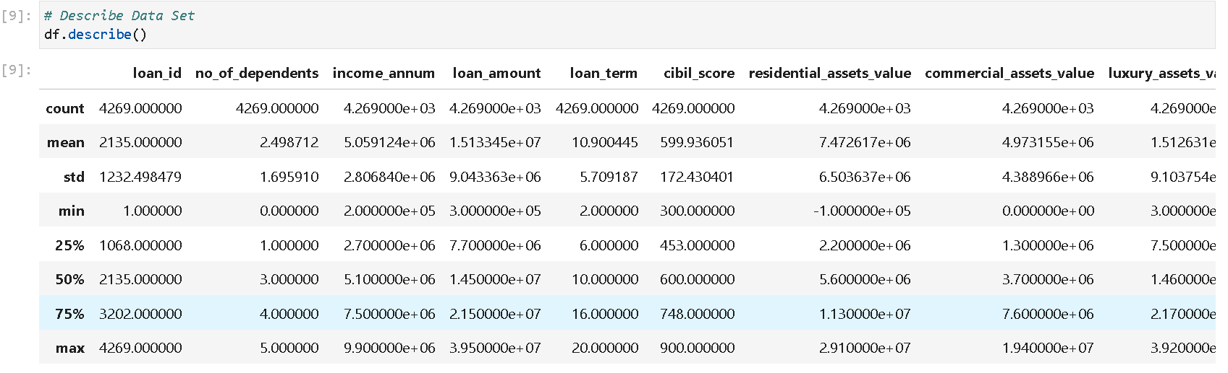
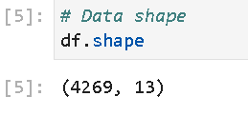
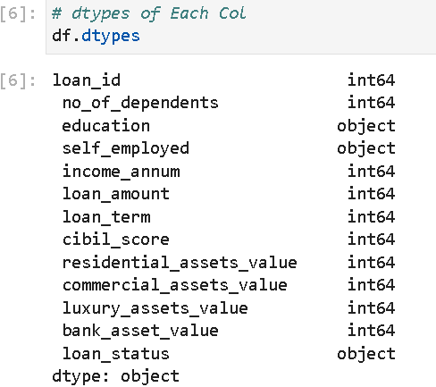
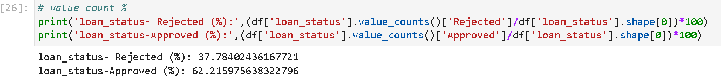
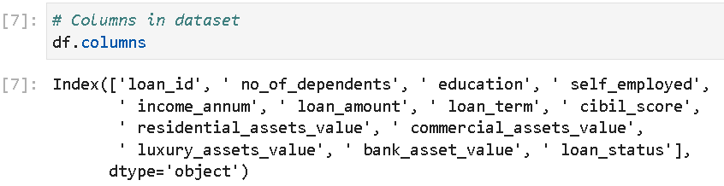
2. Data Understanding
Objective: Gain a thorough understanding of the dataset to identify key attributes and potential issues.
Actions: Load the dataset and examine the structure and types of features

Slide 6
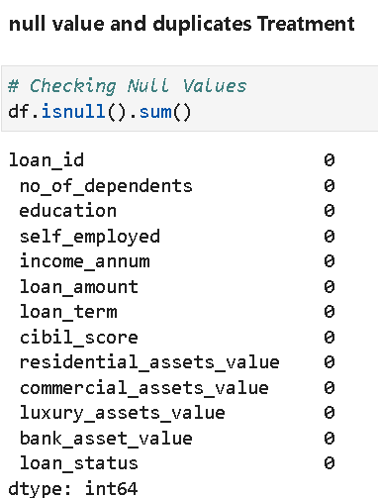
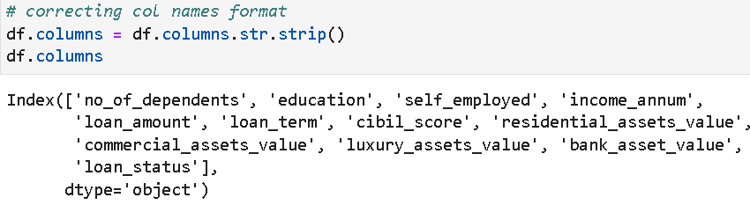
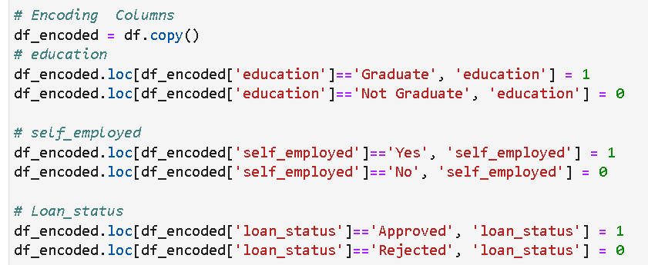
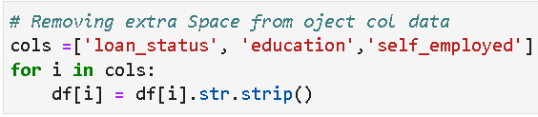
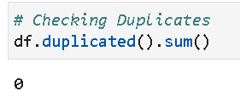

3. Data Cleaning
Objective: Clean the dataset to ensure data quality and consistency.
Actions:
Missing Values and Duplicates Treatment.
Correct any inconsistencies or errors in the data.
Encode categorical variables into numerical format if necessary.

Slide 7
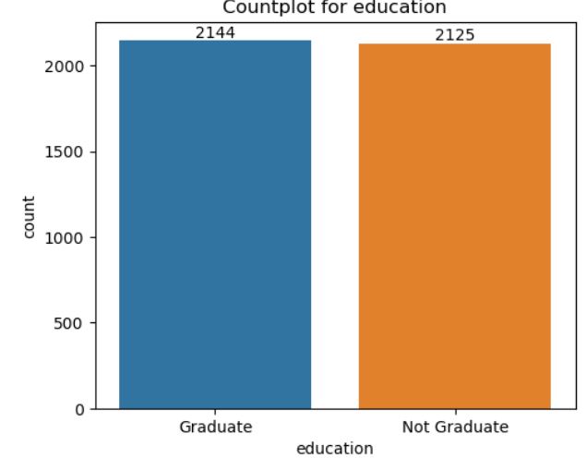
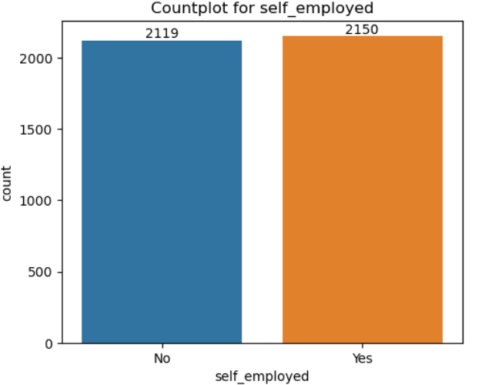
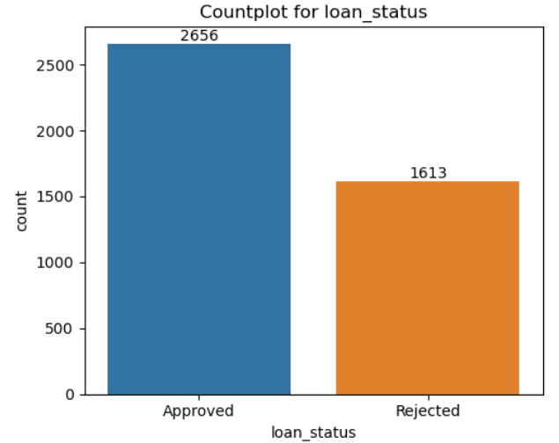
4. Exploratory Data Analysis (EDA)
Objective: Perform EDA to uncover patterns and insights in the data.
Actions:
Visualize the distribution of key features using histograms, and box plots.
Visualize the categorical features using Count plots.

Slide 8
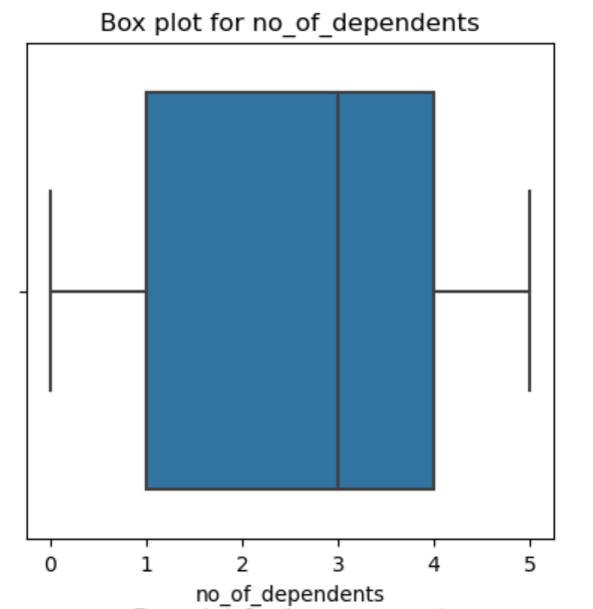
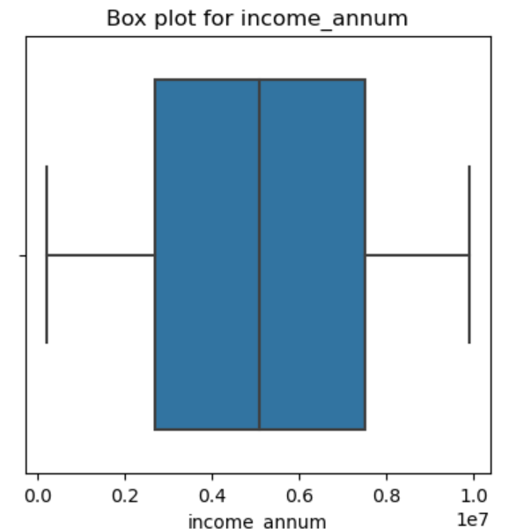
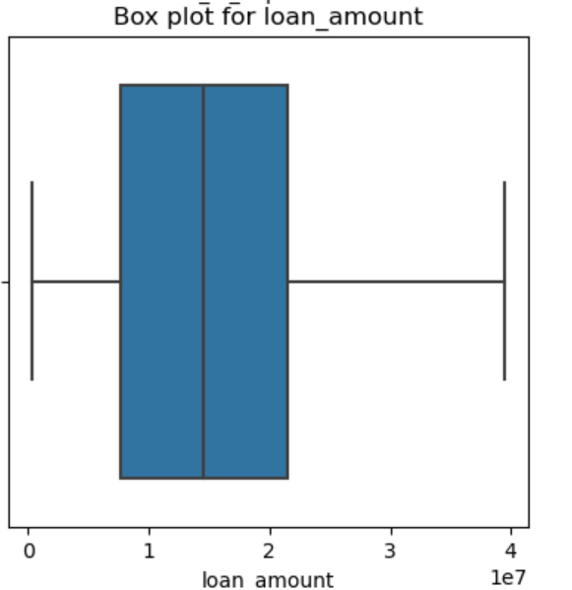
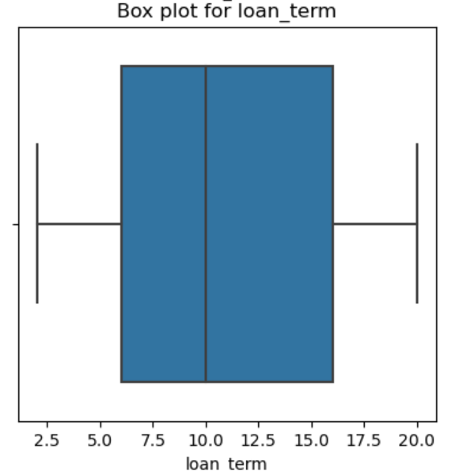
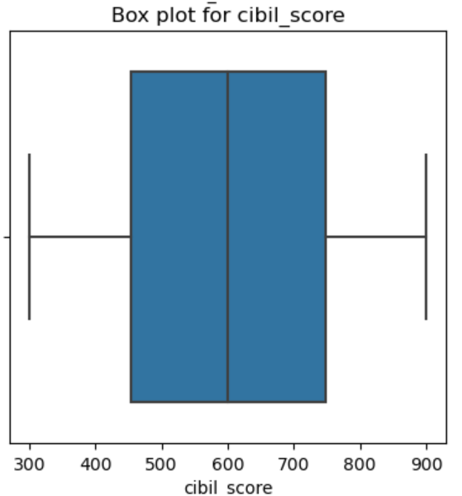
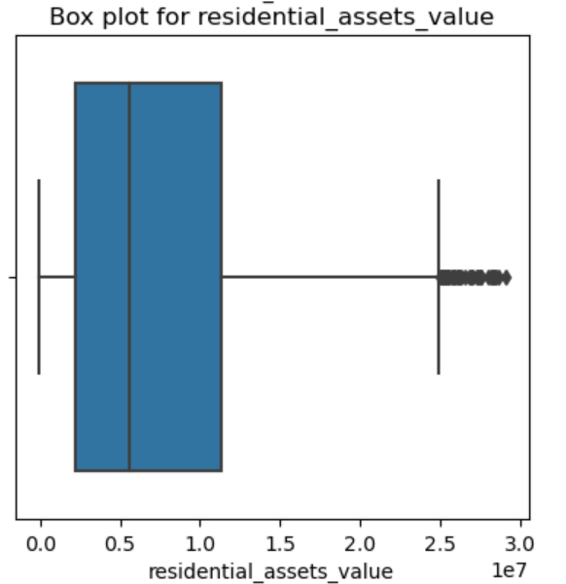
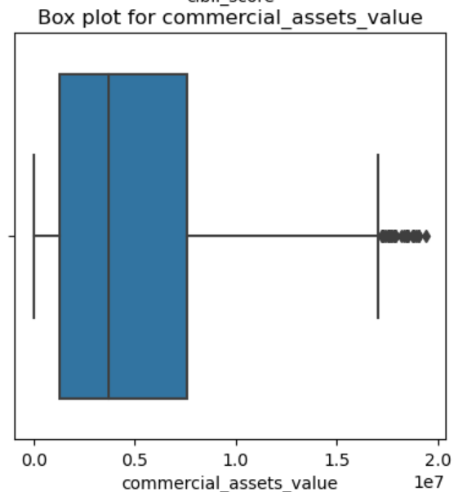
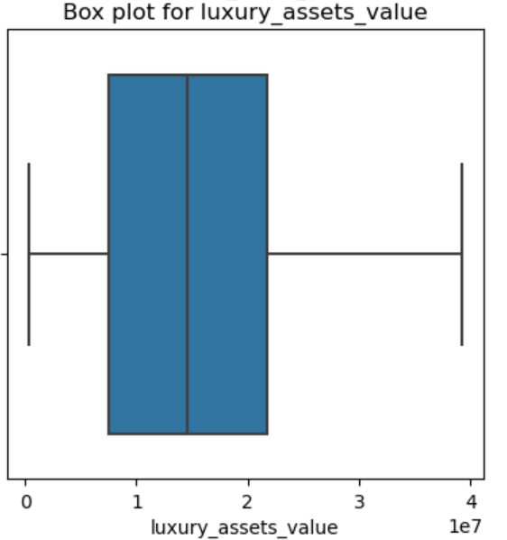
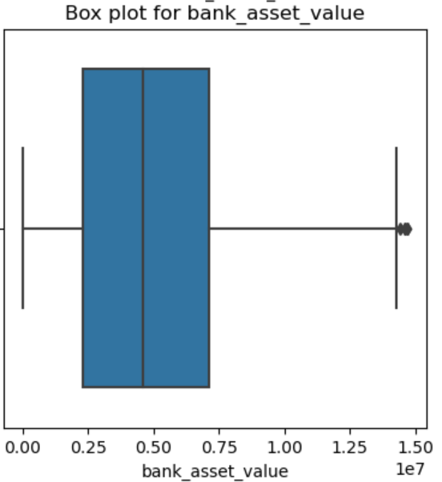

Slide 9
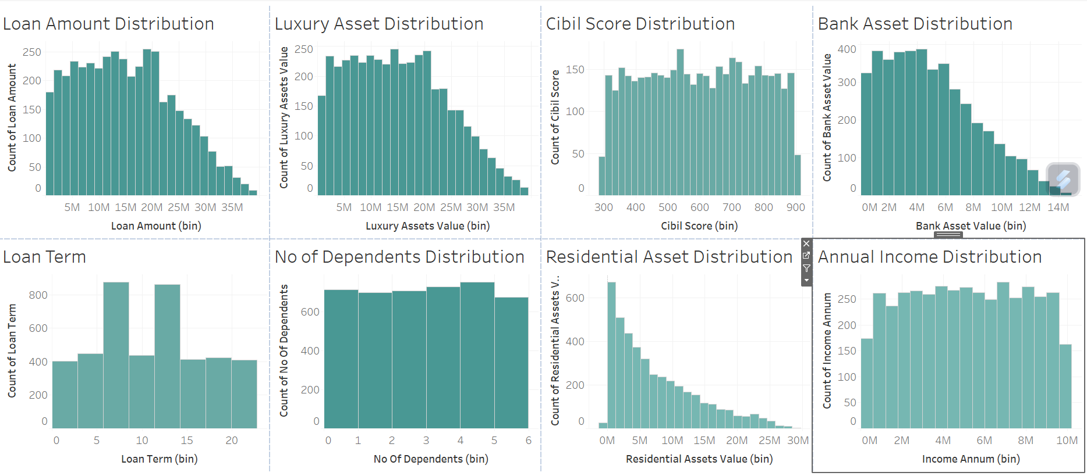

Slide 10
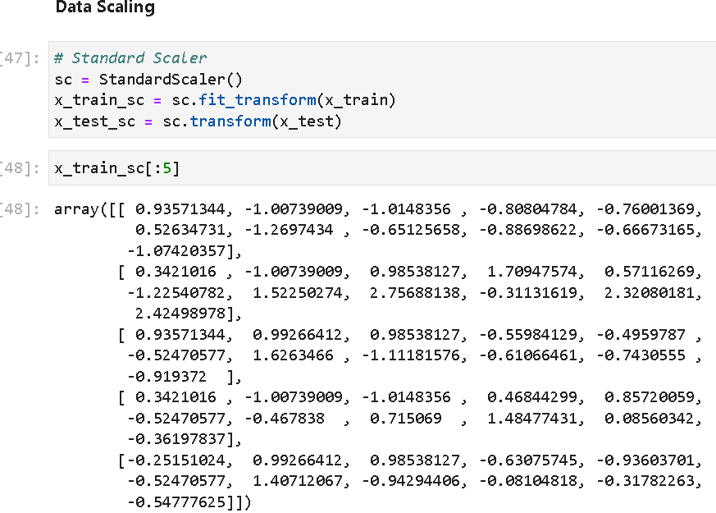
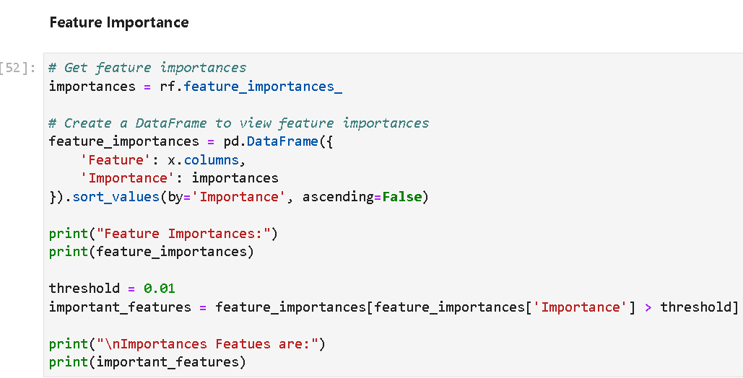
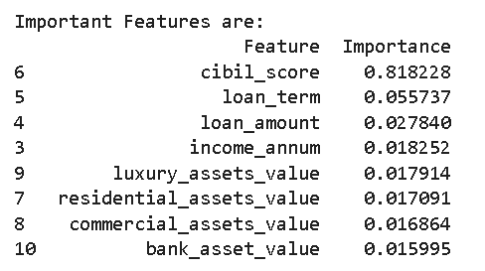
5. Feature Engineering
Objective: Modify features to improve model performance.
Actions:
Standardize numerical features to ensure they are on the same scale.
Perform feature selection to retain only the most relevant features for the model.

Slide 11
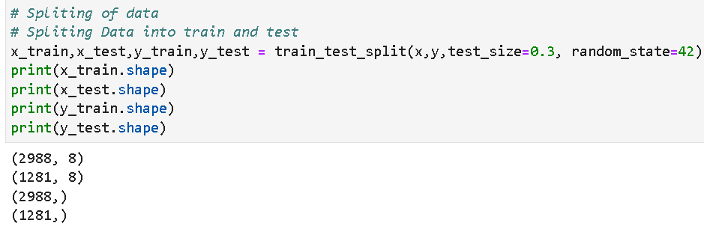
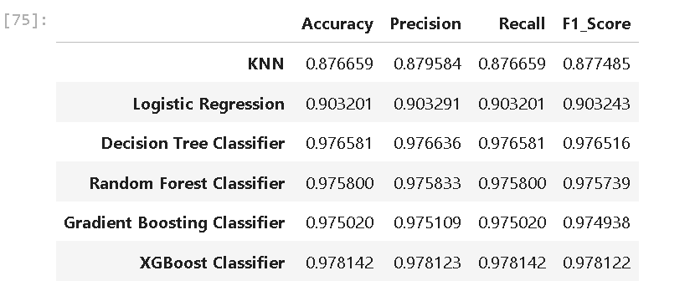
6. Model Selection
Objective: Choose appropriate machine learning algorithms for the task.
Actions:
Split the dataset into training and testing sets to evaluate model performance.
Consider various classification algorithms such as KNN, Logistic Regression, Decision Trees, Random Forest, Gradient Boosting, and XGBoost.

Slide 12
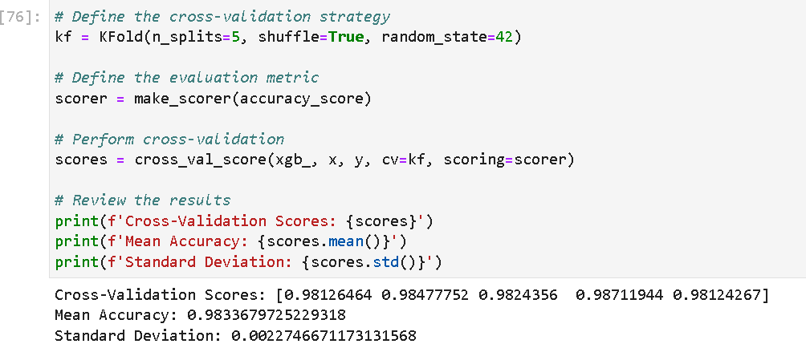
7. Cross-Validation
Objective: Validate the model's performance to ensure it generalizes well.
Actions:
Use k-fold cross-validation to split the training data into k subsets (folds).
Train the model on k-5 folds and validate it.
Average the performance metrics from the k folds to obtain a robust estimate of model performance.

Slide 13
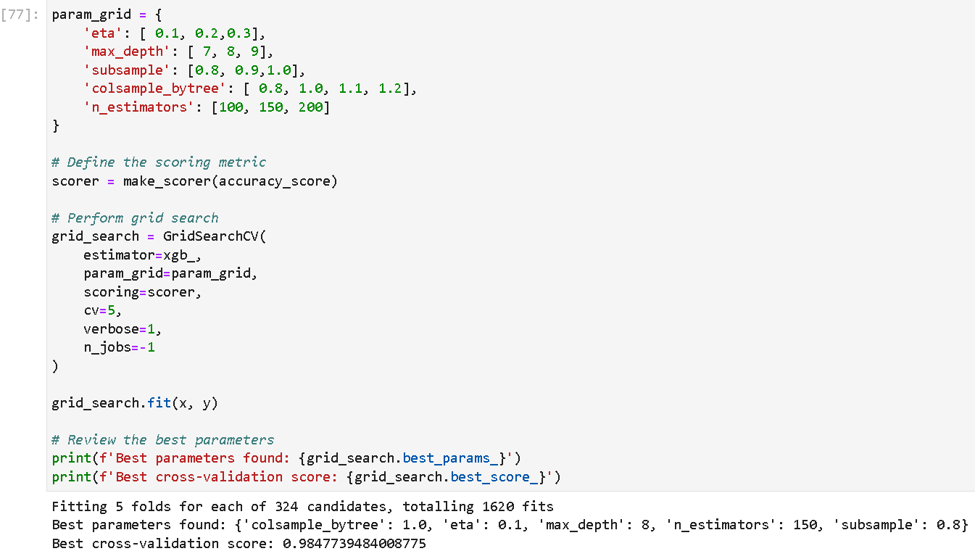
8. Hyperparameter Tuning
Objective: Optimize the performance of the models by tuning their hyperparameters.
Actions:
Used Grid Search to find the best hyperparameters.
Implement cross-validation during hyperparameter tuning to ensure the model's robustness and avoid overfitting.
Evaluate different combinations of hyperparameters to select the optimal configuration for each model.

Slide 14
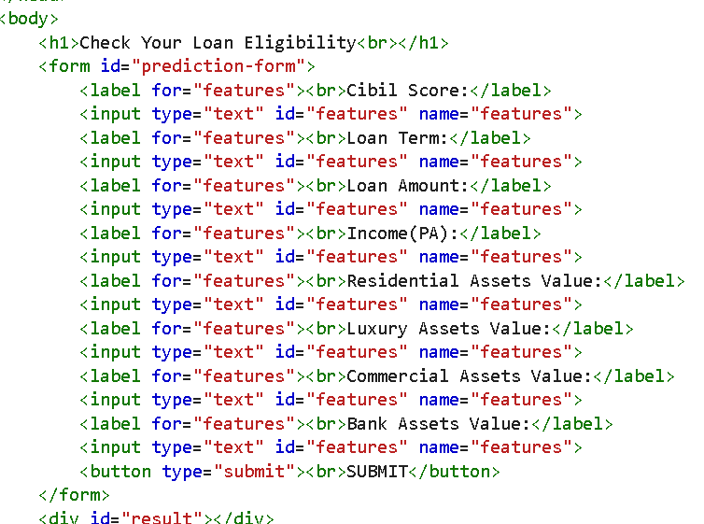
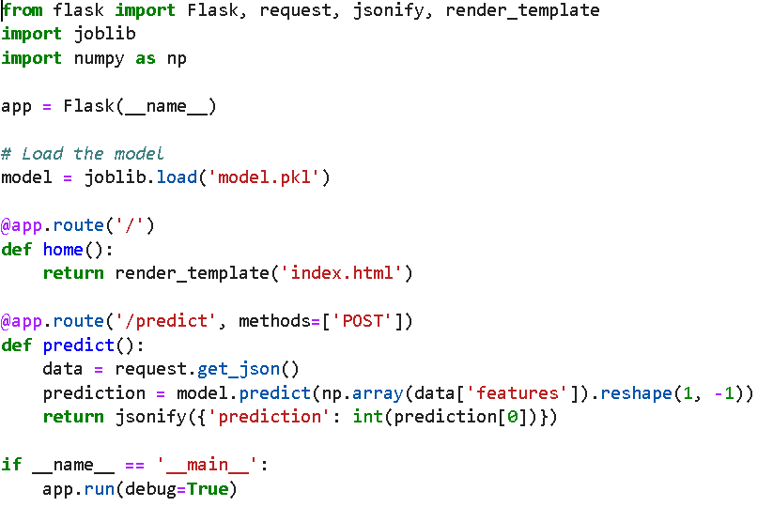
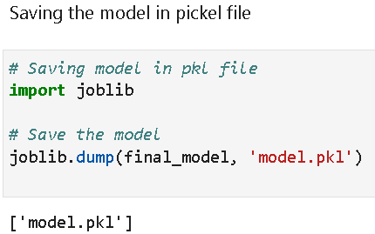
11. Model Deployment
Objective: Deploy the best-performing model for practical use.
Actions:
Save the trained model using serialization techniques (e.g., pickle, joblib).
Develop an API or integrate the model into an existing system for real-time predictions.
HTML & CSS Code
Flask Code
Saving Model

Slide 15
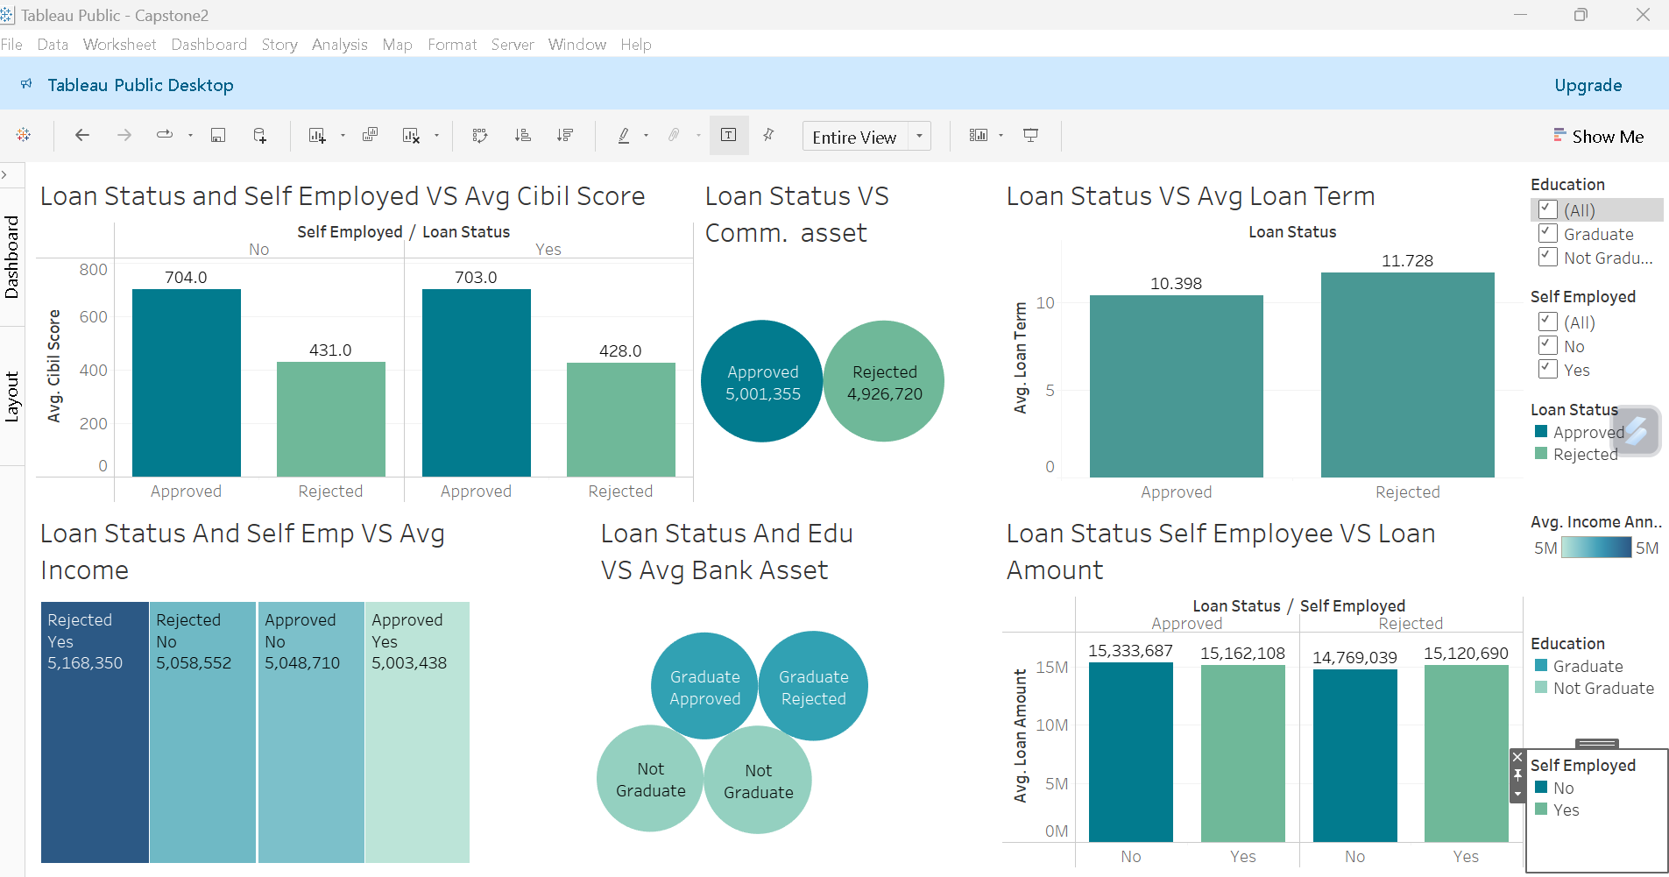
Tableau Dashboard:

Slide 16
Key insights:
CIBIL Score Impact: Approved applicants have significantly higher CIBIL scores compared to rejected ones, regardless of self-employment status.
Commercial Asset Value: Higher commercial asset values are associated with approved loans, indicating a correlation between asset value and loan approval.
Loan Term: Rejected applicants have slightly longer average loan terms compared to approved applicants, suggesting longer terms may be seen as higher risk.
Income Levels: Average income levels are similar between approved and rejected applicants, indicating income alone is not a major determinant of loan approval.
Education and Bank Assets: Graduates with approved loans have higher average bank asset values compared to graduates with rejected loans, highlighting the importance of bank assets in the approval process.
Loan Amount: Approved loans have slightly higher average amounts than rejected loans, suggesting loan size is less critical if other factors are favorable.

Slide 17
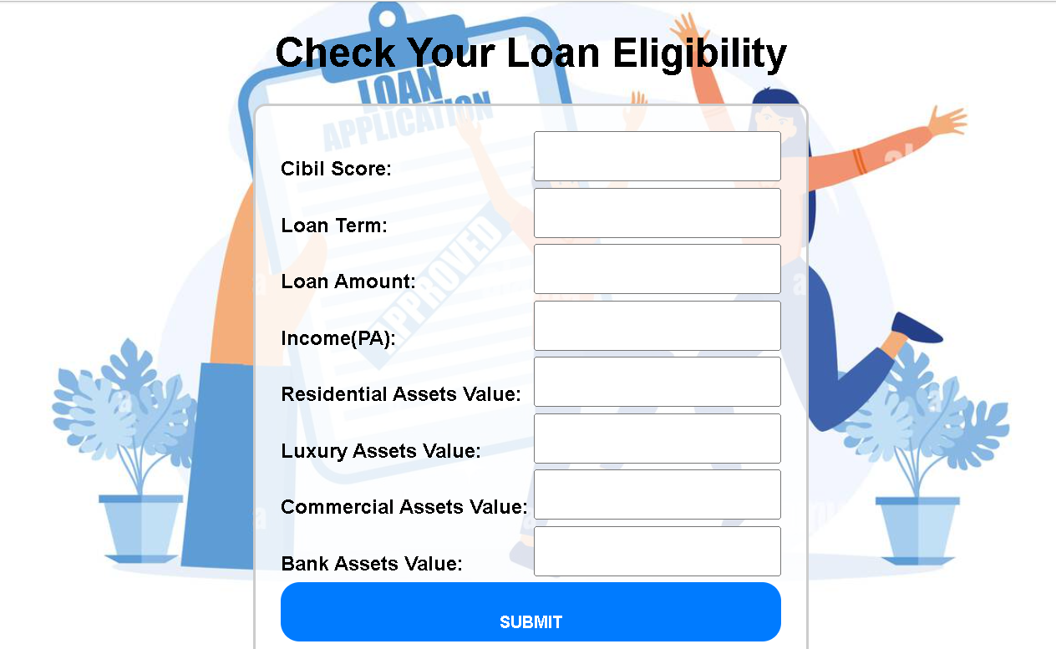
Web App:

Slide 18
Conclusion:
The development and evaluation of the loan approval prediction model have provided valuable insights into the factors influencing loan approval decisions. The model leverages key applicant and loan attributes such as CIBIL scores, income, asset values, employment status, and loan amounts to predict the likelihood of loan approval.

Slide 19
Project Links:

Slide 20
THANK YOU
- Kshma

